Slide 1
The Yahoo! Story
How Yahoo! Mail embraced Automated Testing to Improved Business Efficiency Online
Oct 21, 2015
Neil Manvar, Solutions Architect
Notes:
Name
Present title of talk

Slide 2



Intro
Solutions Architect
Software Engineer (FE)
Bachelors in CSE from UC Davis
Hobbies: UFC (MMA), Cycling, Basketball
Notes:
3 years at Yahoo as FE
2 internships as QE

Slide 3
Agenda
Yahoo Mail team
  how they used to release and operate
  First attempt at solving release and testing challenges
Company and Organization changes
Effect of changes
  How mail team releases and operates now
  Second attempt at solving release and testing challenges
Key Takeaways and “What I’m looking for…”

Slide 4
Yahoo Mail
Team before
  ~200 people
  Bi-weekly releases (train / sprint)
Scale
  TB’s of data going through system every day
Need to support:
  Partners
  > 90 languages
  Browsers
  Platforms
Critical Application
  Email outage has serious consequences
    Users not happy
    $$$ lost
Notes:
Scale: + millions of email
Partners: Nokia and SBC
$$$ lost -> need to pay advertisers

Slide 5
Not So Good Ol’ Days
Release Cycle:
  1 week for development
  Deploy to test server
  QE’s and manual testers test
  Final whiteboard matrix verification
  Push to production
 | Firefox 37 | Chrome 41 | IE9 | …
Folders | Neil | Kevin
Compose | Kevin | Neil | Kevin
Attachments |  | Neil
Notes:
Room for error
Lots time spent doing manual testing
Every two weeks need to do the manual testing

Slide 6
Not So Good Ol’ Days
Testing was problem and bottleneck
  Manual testing not reliable and could not scale
  Bugs / broken features were being released in to production
  Waterfall process would repeat if bug found
  Automated testing not encouraged
Notes:
Manual testing..
Every two weeks, many hours of time, increasing
More features, more browsers -> more testing -> more time spent on manual testing
Waterfall process repeat…
Serious bug, can’t release. Start over with development
Automated testing not encouraged…
No allocated time / plan for A.T.
Depend on manual testing to catch problems

Slide 7
Negative Outcomes of the Not So Good Ol’ Days
Outages / Broken Features
  Browser specific
  Language specific
  Feature specific
  Partner specific
  Display Ads
  Combination of the above

Slide 8
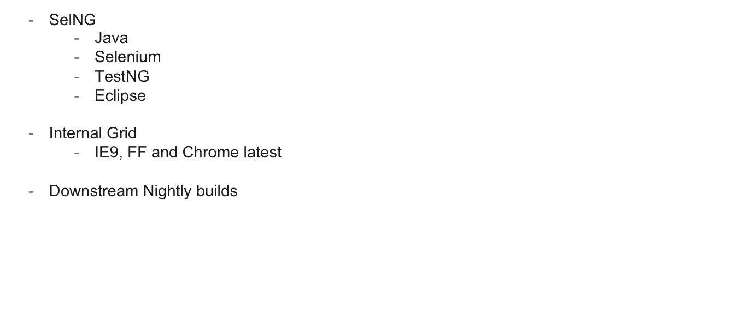
Solution #1 – Invest in Automated Testing
Notes:
SelNG -> Used by Quality Engineers
Internal grid managed by some team members
Looked like a great, viable scalable sol’n, but proved differently as time went on

Slide 9
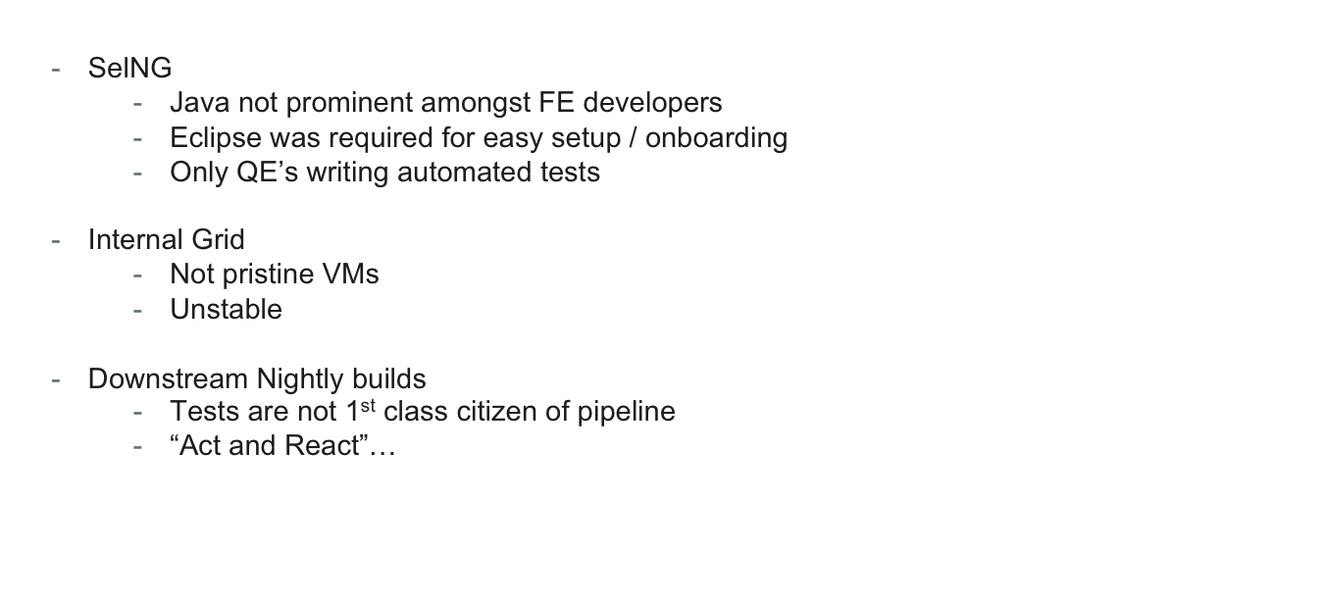
Outcomes of Solution #1
Notes:
Only QE’s writing automated tests
Catching up to source code / developers. Will get left behind sometimes
Internal grid
Not pristine VMs
Run out of disk space or temporary file space.
Unstable
OS, browser updates, machine needs to be restarted
Downstream nightly builds..
Tests are not 1st class… -> if test fail, the pipeline should be halted

Slide 10
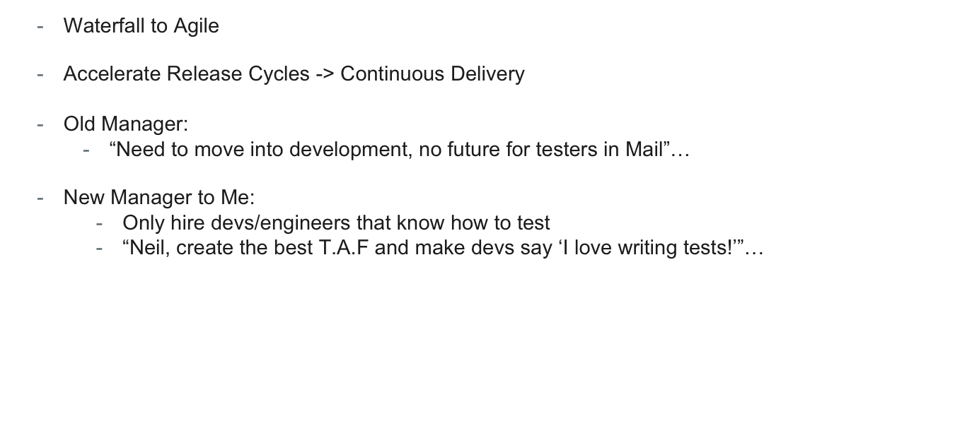
Company and Organization Changes
Notes:
Management was changes. New CEOs
“Neil create…” -> b/c of previous QE experience

Slide 11
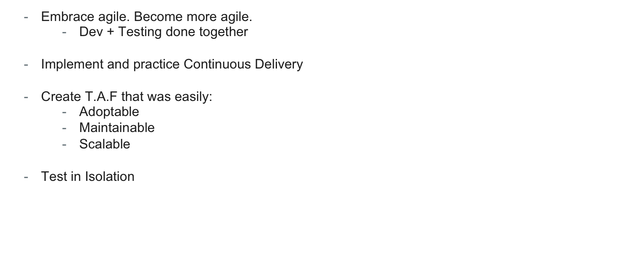
Solution #2 – Agile and Continuous Delivery
Notes:
Implement and practice Continuous Delivery
Be able to Create pipelines that can make sure every commit goes to prod
Create T.AF
That can be used by everyone
Learning is easy
Test in isolation
Test one change at a time, not a set of changes

Slide 12
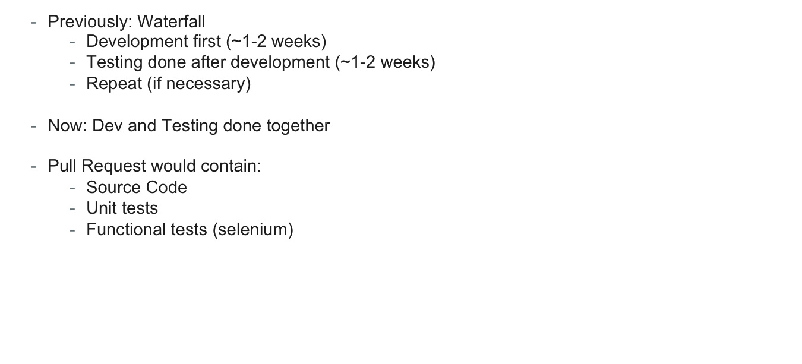
Solution #2 – Become More Agile
Notes:
Previously: Recap…
Dev + Testing done together
Cross functional team (engineers that could write source / test code)
Deliver small, tested, iterative changes frequently
Pull Request…
Peer reviews
No legacy code (unmaintained and untested)

Slide 13
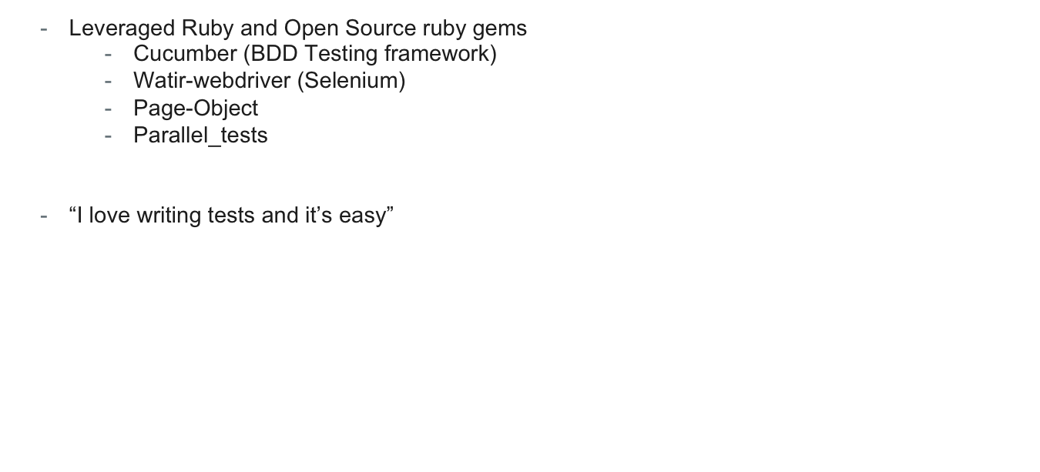
Solution #2 – Test Automation Framework
Notes:
Cucumber – easy to read and identify issues because of its english-like syntax
Watir-webdriver -> implementation of Ruby Binding for selenium
Page Object -> abstract away selectors from the logic that interacts with the elements
Documentation and training
Gem updates

Slide 14
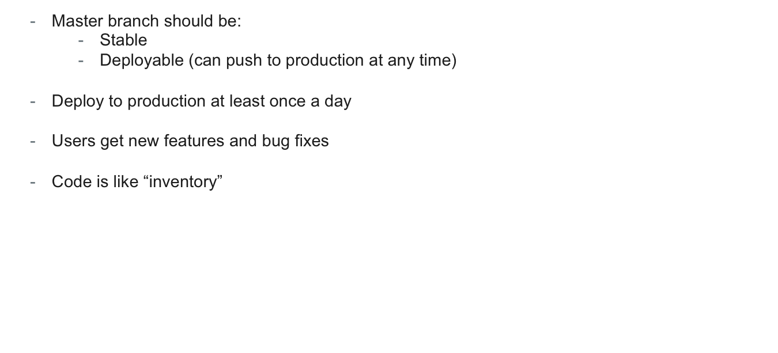
Solution #2 – Continuous Delivery
Notes:
Continuous Delivery
Def: building, testing, and releasing software faster and more frequently
Def to us: every commit is ready to be pushed to production
Code is like “inventory”
If you had a shoe store…sell shoes, get ne inventory, sell inventory, repeat…

Slide 15
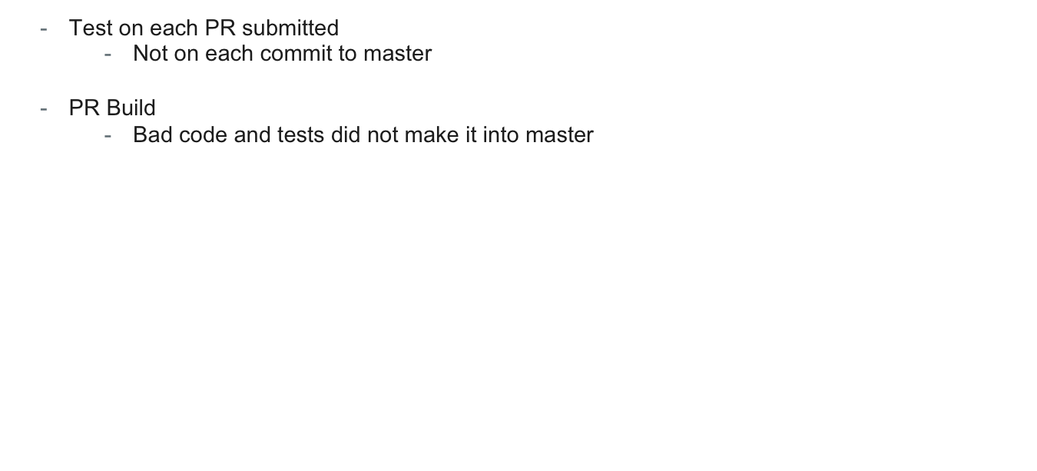
Solution #2 – Test in Isolation
Notes:
PR Build
…
Enforcing over policing
UT and Func Tests should pass
Code coverage enforcer
Coding standard checker

Slide 16
Solution - PR (Pull Request) Build
PR Build
(UT and Func Tests)
Kick off build against PR branch / code
Safe to merge?
Only merge if marked as safe
PR
QA Build
(UT and Func Tests)
...
PR
PR Build
(UT and Func Tests)
Notes:
Create build
Enforcing…
Push to production
Explain why this avoids rollbacks
i.e. why bad code never makes it into master

Slide 17
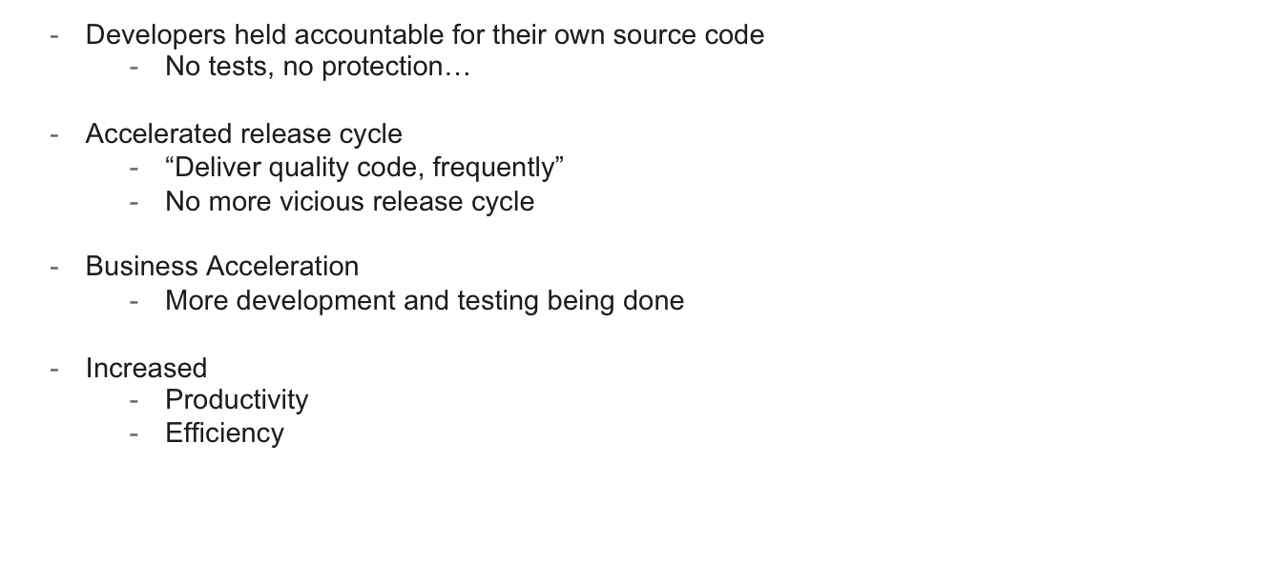
Outcomes of Solution #2
Notes:
No tests, no protection -> responsible for writing tests.
Show how untested code and go out and result in broken feature
No more vicious release cycle
No more release day, always releasing or always ready to release
More dev and testing being done
Source code and test code for source code
Can ship more code and features to users
Increased productivity and efficiency
Enabled growth
Result was better, more stable, product and happier customer

Slide 18
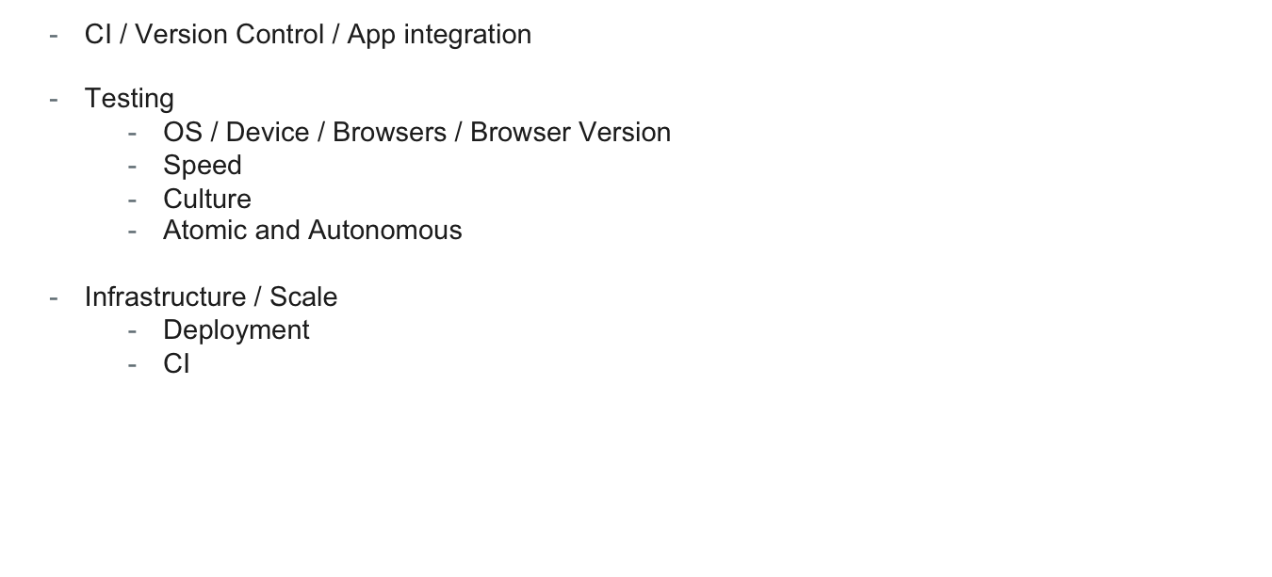
Solution #2: Challenges
Notes:
Atomic and Automonous => problems with parallelization
Infrastructure / Scale
Scaling PR build

Slide 19
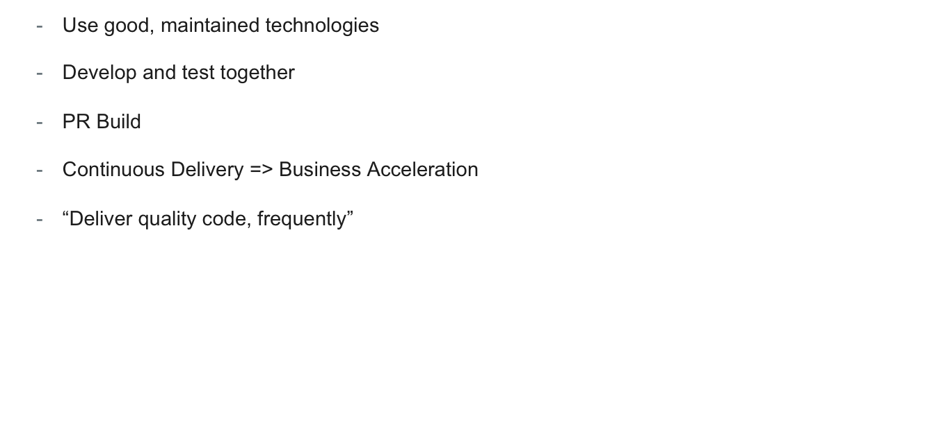
Key Takeaways
Notes:
Good mainted tech -> Open Source
PR Build
Enforce vs “act+react”
Avoid rolling back

Slide 20
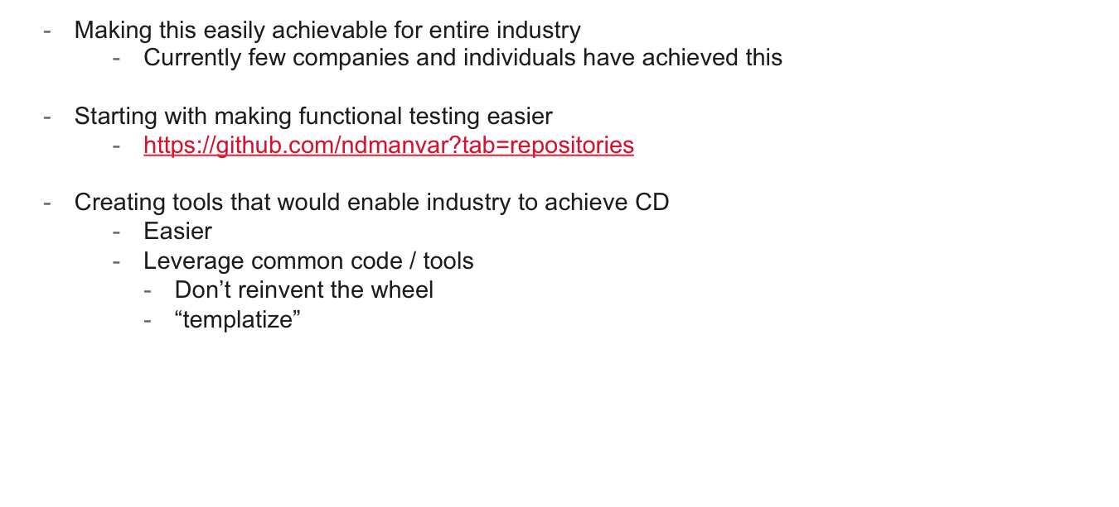
Looking for…
Notes:
Create tools that would enabled industry to achieve CD + PR request build
Explain “templatize”
i.e. Screwdriver
Give name, git repo, tech stack, and build scripts. Out comes CD pipeline with PR Build

Slide 21
Questions?
neil@saucelabs.com

